Slide 1
Rethinking Education, Embracing Choice and Diversity Hong Kong, 10-13 October 2014 Dr Paula Rothermel FRSA, Open University Chartered Psychologist Expert Witness (HCPC registered)
p.j.rothermel@bluewin.ch
www.paularothermel.com http://www.linkedin.com/ http://scholar.google.ch/

Slide 2
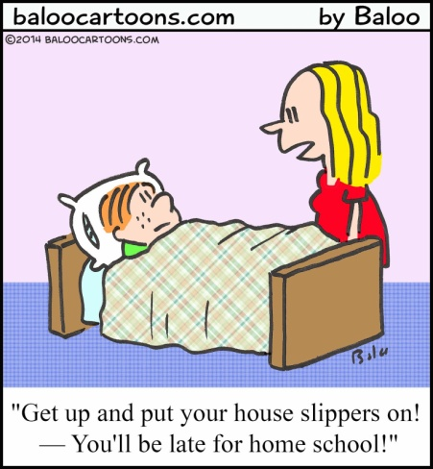
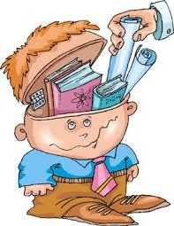
what we know about home education and the lessons we can learn
VERSUS
Notes:
Stereotyplcal school verusu home education (Europe)

Slide 3
I am going to talk about:
Short introduction about me
Summary of my 2002 research
What we know about home education
Evidence schoolchildren leap forwards?
The benefits of a later school starting age
Influence of love (the undervalued power of love)
Conclusion

Slide 4
About me
My doctoral research spanned seven years and involved over one thousand children.
After completion I was awarded a Economic and Science Research Council Post Doctoral Fellowship.
I have been interviewed many times for the BBC, ITV, newspapers and radio.
Spoken at numerous mainstream national and international education conferences
Have a reasonable publishing record.
I have worked as an expert witness at court since 2002.
My work has been cited at Westminster Debates (UK government) on several occasions.
I am a qualified and registered child & educational psychologist
I have been attached to Durham University and the Open University
I have taught in secondary schools and for some years was a Local Authority appointed school governor.

Slide 5
Rothermel, P. J. (2007) Home-Educated Children: a portrait. Conference Paper presented in Estonia The Estonian Centre for Home Education Annual Conference.
Rothermel, P. J. (2007) Home Education: A Desperately Dangerous Notion? Conference Paper presented at ECER Ghent 2007.
Rothermel, P.J. (2009) ‘Research by Paula Rothermel’ in Teach Yourself Home-Education, Durbin, D., Londond: Hodder Education
Rothermel, P.J. (2009) ‘Aprender de los Educadores en Casa’ in Educación in Casa, Oprean, S. (ed).
Rothermel, P.J. (2009) Home Education: A Desperately Dangerous Notion? Conference Paper presented at ECER 2009 Vienna - European Conference on Educational Research 28-30 September.
Rothermel, P.J. (2009) ‘Home Education in the UK’. Keynote Presentation at the Seminario de Educacion y Cencias Sociales Bogota, Colombia. 4-6 November 2009.
Rothermel, P.J. (2010) Panellist invited to the Westminster Briefing Day on Home Education, ‘Regulating Home Education and Supporting Home Educators: Implementing the New System’ 26-02-10.
Rothermel, P.J. (2010) (Ed) Intercultural Perspectives on Home Based Education. Multilingual Matters (in prep).
ROTHERMEL, P.J. (2010) ‘Home education: practising without prejudice?’Every Child Journal. Vol. 1.5 June 2010. pp48-53.
ROTHERMEL, P.J. (2011) ‘Setting the record straight: Interviews with a hundred British Home educating families. Journal of Unschooling and Alternative Learning Vol. 5, Issue 10, Summer, 2011
ROTHERMEL, P.J. (2011) British Education Research Association (BERA) Invited Discussant
ROTHERMEL, P.J. (2011) Educación en casa: una cuestión polémica. Paper presented as an invited speaker at the II Congreso Nacional y I Internacional sobre Educación en Familia-Homeschooling: “Innovación educativa y escuela flexible”. Universidad de Navarra. 25-28 November.
ROTHERMEL, P.J. (2012) ‘Home Educated Children’s Psychological Well-Being (El Bienestar psicologico de los ninos educatos en casa)’ Estudios Sorbre Educacion. Vol 22 pp13-16.
ROTHERMEL, P.J. (2012) ‘Educación en casa: ¿un concepto extremadamente peligroso?’ In Un Mundo por Aprender : Artículos de Congresos 2009 y 2010. Ed. Erwin Fabián García López, E. Colombia: National University of Colombia. Universidad Nacional de ColombiaUniversidad Nacional de Colombia Universidad Nacional de Colombia
ROTHERMEL, P.J. (2013) ‘The Importance of Parental Involvement in Children's Learning (Homeschooling UK Comparison of 4-5 year olds in and out of school). IDistinguished Speaker at the Homeschool Conference. 24th August
ROTHERMEL, P.J. (2014) ‘The Later the Better’. Invited Key Note Speaker. Conference ‘Mainstream Tomorrow’, Oslo. 19.1.14. ROTHERMEL, P.J. (2014) ‘The Later the Better’.
ROTHERMEL, P.J. (2015)(Ed.) ‘International Perspectives on Home Education’. London:Palgrave Macmillan. ROTHERMEL, P.J. (2014) Early education in and out of school. Toledo. Invited speaker. September 2014.

Slide 6
Forthcoming publications:
‘What We Know About Home Education’ (CreateSpace 2014)
Intercultural Perspectives on Home Education: Do we need schools (Palgrave Macmillan 2015)

Slide 7
Rothermel, P. J. (2002) Home-Education: Aims, Practices and Outcomes.
The research involved:
419 home-educating families
1,099 children
'Notschooled' children make an extremely interesting group to study. Study of them is one way we can understand more not just about home education, but also about the value of schooling
My own research is far from perfect, BUT, it does provide a window onto home education and remains the largest ever study into home education in Europe.

Slide 10
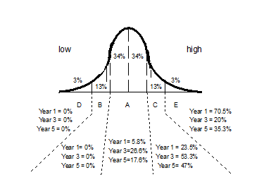

Slide 13
Combined standardised National Literacy Project scores children ‘in’ Years 1, 3 and 5
68% percent of children are expected to score 85 - 115. Within the sample of 41 randomly selected home-educated children, 17% fell into this category, whilst 80.4% scored in excess of 115 points. Nineteen children, 46%, scored above the highest measurable score of 130.

Slide 15
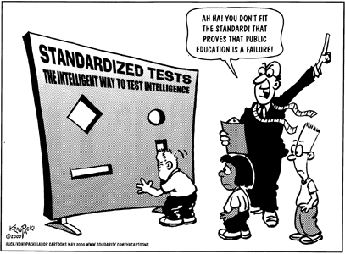
If agencies adopt psychosocial 'norms' by which to judge such children, they will almost invariably find these children to be outside the 'norm'. What is desirable behaviour from a schoolchild is very different from what is deemed desirable behaviour from a home-educated child.

Slide 16
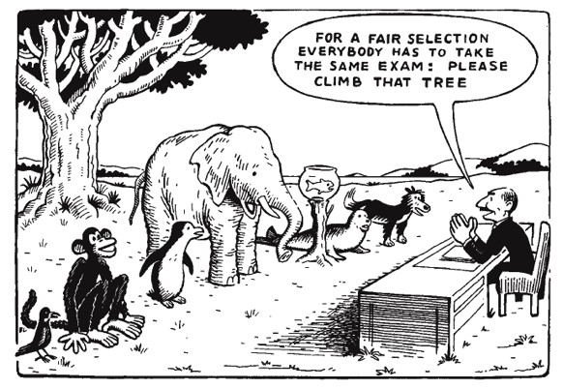
baseline assessments were not useful in finding out about the home-educated children .
The tests gave no insight into the extent of these children's learning. The research indcated the children's learning was best described as a multidirectional and mutlilayered model, and that such a model was not provided for by standard tests.

Slide 17
The range of ways in which children are educated at home.
:Illustration of approaches to home-education in very approximate terms
Notes:
The range of ways in which children are educated at home. Home education can take a variety of forms ranging from the formal to the informal. However, it should be understood that formal home education is not in any way the same as formal school education. The overall format for home education is characterised by liquidity and flexibility, and can be described as follows:
All the types of home education can be set along a spectrum from an informal child-led approach, through a mid point, to a didactic, parent-led style. All approaches on this spectrum are child-centred in that the education revolves around the individual child or children's needs.
Families often use different approaches for different children, thus whilst one child may prefer a workbook or curriculum led education, another child may respond better to a more liberal style.
Parents tend to adapt their approach depending on age. Researchers such as Thomas (1998) have found that families who have recently withdrawn children from school tend to follow a curriculum initially but that they relax this over time as they move to a child led approach. However, Rothermel (2002) has concluded that where there is a change in style, parents of children home educated from birth tend to move from the informal to the formal, that is, the reverse of parents who have withdrawn their children from school.
a simple definition of the styles is as follows:
Child-led. These families tend to take each day as it comes and to follow the children's lead.
Mixed. These families will adopt more of a shared approach to learning. The parents may expect some formal input from the children but will also follow the children's lead in giving them plenty of freedom to decide for themselves what they want to do.
Parent-led. It is more likely that these children will follow a purchased curriculum and their parents will take all decisions about how the children's days are organised.

Slide 18
Notes:
SEE NOTES

Slide 19
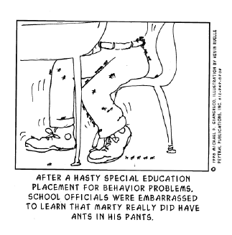
At 4 or 5 when school children sit engaged in concentration, the home educated child of this age is rather more active.
Notes:
Children labelled by others as hyperactive. At 4 or 5 when school children are usually able to write and read a little and sit for periods at their tables engaged in teacher directed activities involving concentration, the home educated child of this age is very often still at a play based stage, where he or she is not required to sit and learn or raise a hand to ask a question. It can seem, to an onlooker, that these children are hyperactive, unable to engage in 'proper' activity, and that they are unruly.

Slide 20
Moving from home to school education.
How long does home education last?].
Formal Qualifications.
Do home-educated children get jobs?
Notes:
SEE NOTES

Slide 21
Notes:
Criticisms. Critics of home education criticise home education for the lack of exposure to diversity, the lack of participation in greater society and the potential difficulty entering mainstream life, but there is no research evidence that I am aware of to support this viewpoint. Research with home-educated adults indicates that they contribute far more to community activities than their schooled counterparts.
In the UK Home educating families often report that they feel vulnerable to criticism by non home educators on the issue of their children's socialisation and assumed isolation (Rothermel 2002). This exposure to criticism may well stem from the lack of information held by LAs and government about home educators.

Slide 22
Notes:
Badman 2009
Cover for child abuse
Statis rejected by the select committe for education 2010

Slide 23
Statistics show that children make a huge leap forwards when they enter school
Tymms et al. (1997) found that the children make a leap forwards in learning when during their first year of school.
They reported that:
'[…] it is hardly an unexpected finding to discover that teaching advances learning […]. […] For progress what really mattered was attendance at school, the pupil's prior achievements and the school that they attend.'
Tymms et al. (1997 p. 117)
So….how did they arrive at this conclusion?

Slide 24
Statistics show that children make a huge leap forwards when they enter school (Tymms et al. 1997)
4.11 years
4years
4.11 years
18 points between oldest & youngest child‘s results
60 points between Start and End of reception results (over 11 months)
A 42 point leap over the school year!

Slide 25
My finding (discussed in Rothermel 2004), using the same test material, was that the difference in test scores between the youngest and oldest at ‘entry’ was 10.22 points and that the difference between the average grade on ‘entry’ and ‘exit’ was 54.54.
That is, the home educated cohort increased their grades during that year by 45.32 points in contrast to Tymms’ 42 point average.
10.22 points between oldest & youngest child‘s results
4years
4.11 years
54.54 points between Start and End of Reception results
(over 11 months)
A 45 point leap over the (non) school year!

Slide 26
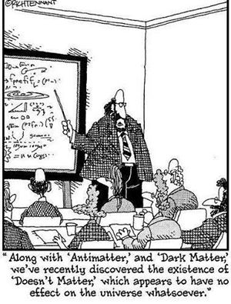
Quite possible and likely, however, is that children between 4 and 6 simply do make a seismic shift in their cognitive development and that it doesn’t matter if they are at school or not.

Slide 27
CHILDREN ARE ACTIVE IN THEIR OWN LEARNING
Piaget taught us about the tremendous capacity for children to self organise and learn from the inside out.
Karmiloff-Smith described the way in which children take on board information from the external world, reorganising it internally and combining it through conflict and, or agreement with previously internalised knowledge, eventually attaining mastery over the situation. She described this process as 'representational redescription' (RR).
Rothermel (2002) and Thomas and Patterson (2008) conclude that in the home education context, children absorb their knowledge gradually by virtue of informal repetition, and assimilation through everyday learning involving the natural process of dialogue and exploration. This style of acquiring information has been found by researchers to be beneficial (e.g. Edmondson 2006).

Slide 28
Pine, Messer and Godfrey (1999) looked into the effects of didactic versus guided teaching of a balancing task.
The taught groups received instruction
The control group had none (they were allowed to practise alone)
Before intervention all the children scored poorly on the task. Following intervention, all three groups improved significantly.
Retested a week later.....
the didactic group had regressed
the guided participation group had remained at virtually the same
The control group (with no tuition), however, had improved to a level exceeding the guided participation group.

Slide 29
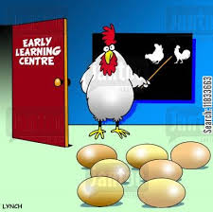
LATER SCHOOL STARTING AGE
Research supporting a later starting age for formal education in the UK is growing. In many states of the US, formal education does not begin until children are aged 6, 7 and in Washington and Pennsylvania 8 years of age. In Finland, formal education does not start until the year that children turn 7, and in Sweden it is also usually 7 but can be postponed until 8 years of age.
A number of organisations have sprung up in the UK, lobbying for a later school starting age, such as, the "Too Much, Too Soon campaign”.
The concept of ‘school readiness’ is a fashionable new term and is often confused with simple ‘readiness’.
Notes:
The concept of ‘school readiness’ is a new one and is often confused with simple ‘readiness’, not forcing children to learn a task or a skill until they seem competent. By talking parents into believing in ‘school readiness’, the state plays to the ego of the parent. A parent whose child goes a earlier to school is often proud to say, “He’s ready for school”.
This implies the arrival of a time when a child is ready to learn what the state decide it should. This ebbs away at the intuition and inventiveness of parent power.

Slide 30
2009 Cambridge Review of Primary Education argues for delaying the onset of formal schooling until aged 6, on the basis that 5 year olds risk having confidence dented by early formal education.
The line taken is that 90% of the world start formal schooling aged 6 or 7 (World Bank data) and that research shows that children starting school aged 6 or 7 perform better on educational testing as well as higher levels of well-being. This seems born out by UNICEF 2009 report on children’s happiness which places the UK at the very bottom in world rankings
My research indicates that the early ears are perhaps the ideal time to leave children alone and let their brains in their own time. That if we are looking to create innovation in our next generations, the last thing we should be doing is prejudicing their brains at the very time they should be left open to wonder at the world and start to make sense of it for themselves.

Slide 31
INFLUENCE OF LOVE (The Undervalued Power of Love)
During recent years there has been a wealth of research concerning the importance of parental involvement in children's development. This was highlighted in a government funded meta analysis of 14 studies which concluded:
"Parental involvement in the form of ‘at-home good parenting’ has a significant positive effect on children’s achievement and adjustment even after all other factors shaping attainment have been taken out of the equation"
(Desforges and Abouchaar, 2003 p. 4)
The UK DCSF funded Family and Parenting Institute further supports this finding, stating, “It is now well evidenced that the home learning environment is more influential in determining children's outcomes than parental occupation, education or income” (FPI 2009).
Further, the 2009 Children’s Society report concluded: “A child’s relationship with their parents is pivotal in them achieving a good childhood” and Sylva et al. (2003), described a parenting style that has been as making the greatest contribution to children's attainment, that of the, ‘involved parent’.

Slide 32
Input into a child’s learning can involve as little as just being there for their child, answering or helping to answer questions as and when they arise and facilitating resources and activities (Rothermel 2002).
Professor Layard has written about the economic value of happiness (Layard 2003). Further, Research has shown that brain development is inseparably linked to love (Gerhardht 1994).
Tizard and Hughes (1984) found that parents had the advantage of understanding the context of their children's lives in a way that teachers couldn't. In the last lines of their book they write:
'Indeed, in our opinion, it is time to shift the emphasis away from what parents should learn from professionals, and towards what professionals can learn from studying parents and children at home.'
Tizard and Hughes (1984, p 267)
Surely if parental input is so strong, the state should be offering to pay parents to stay home and take over the early years education?

Slide 33
CONCLUSION
Once we stop believing in our own capacity as parents to encourage our children, once we are so dependent on being told what to think, there will be no one left to ask questions or to question the wisdom of the state.
THANK YOU FOR LISTENING

