Slide 1
Dr Simpson Wong
Department of Psychological Studies
Hong Kong Institute of Education
The scientific evidences that prompt us to act early:
The case of listening

Slide 2
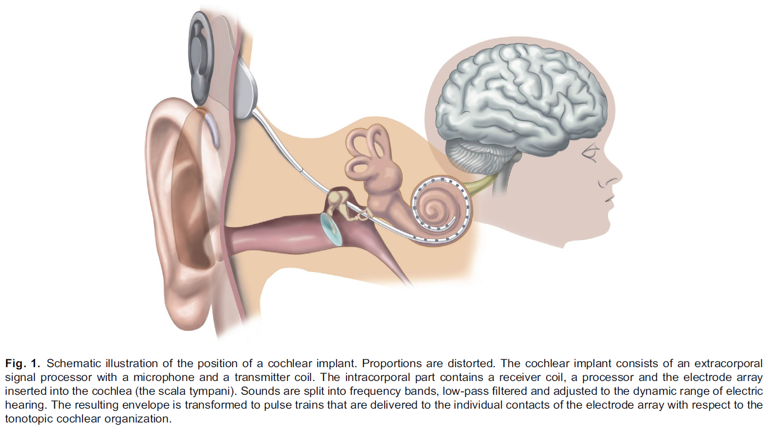
A critical period for the therapy of human prelingual deafness exists
Implantation in teen ages among prelingually deaf lead to poor speech understanding (Tong et al., 1988; Busby et al., 1992, 1993)
Speech processing performance is influenced by implantation age (Yoshinaga-Itano et al., 1998; Geers and Sedey, 2011).
(Kral, 2013)

Slide 3
Critical and sensitive periods
Types of sensitive periods (Kral, 2013)
  Development: experience is required for the development of a particular skill within a period
  Damage: the human system is vulnerable by manipulation of experience like monocular deprivation
  Recovery: therapy (compensation of a deficit) is only partially possible after some age has been missed
Interlanguage fossilization (e.g., Selinker, 1972; Han, 2004)

Slide 4

The discrimination of native and non-native phoneme contrast
(Werker & Tees, 1984)
Lentil
Branch

Slide 5
Racing with genes and biology
Human development begins at the point of conception (or even earlier)
We race with the biological clock

Slide 6
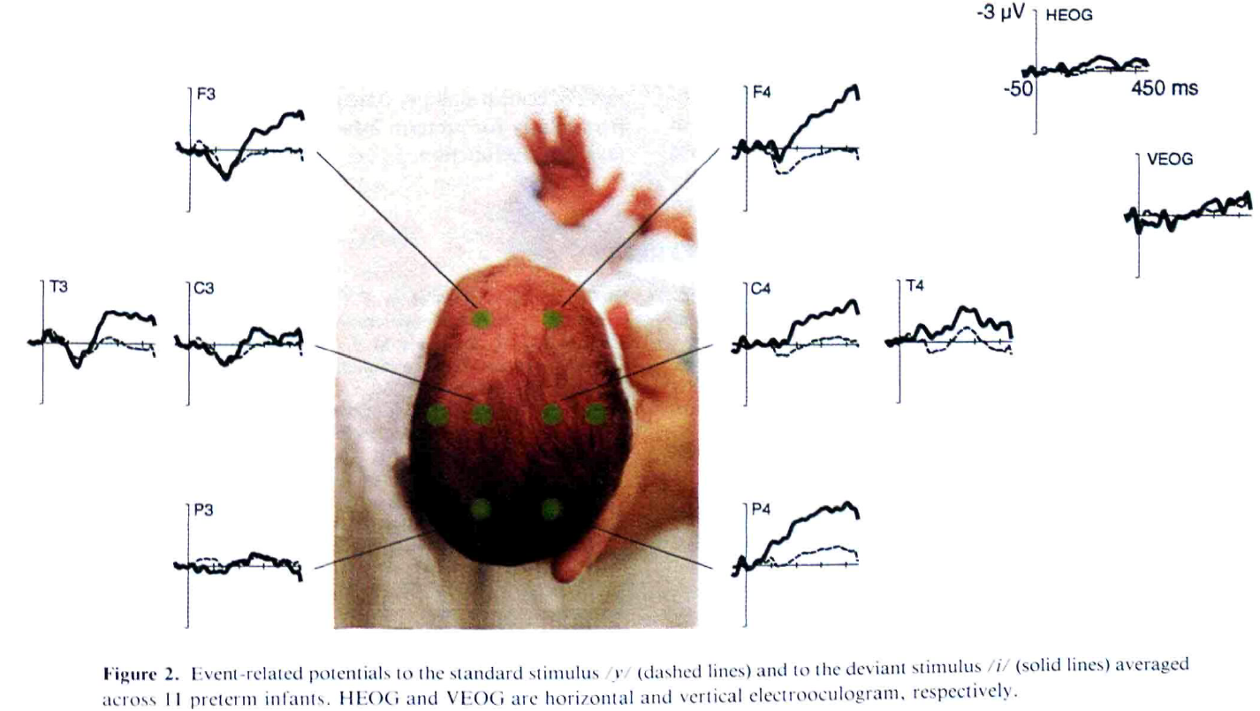
Premature infants respond to vowels (Cheour-Luhtanen et al., 1996)

Slide 7
Because the womb is a high-frequency filter, many phonemes are strongly degraded in utero (Pen˜a, Werker, Dehaene-Lambertz, 2012)

Slide 8
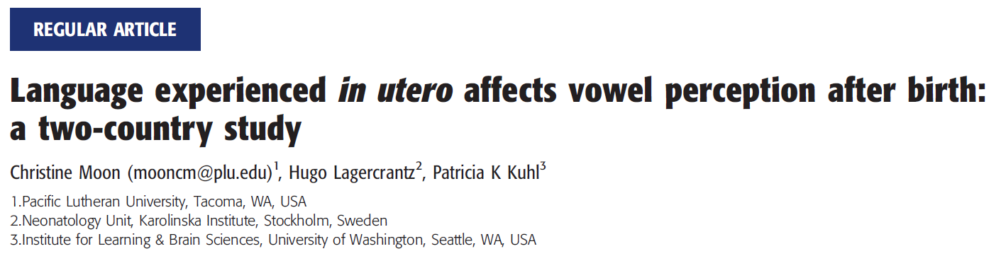
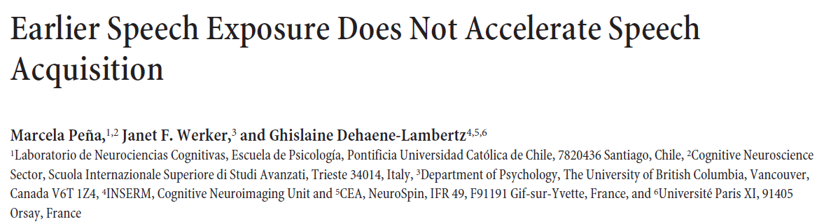
Who to believe?
Versus

Slide 9
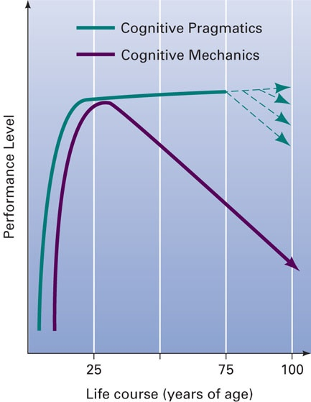
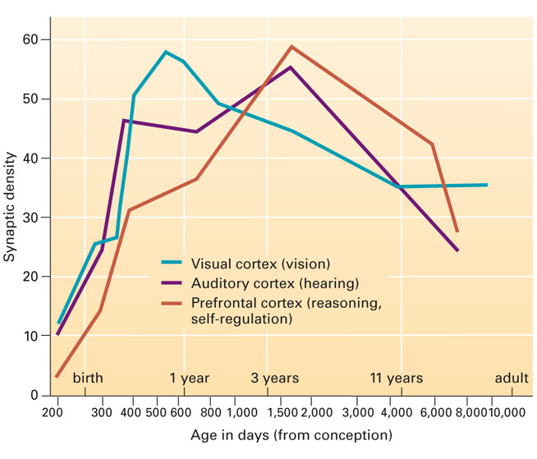
Attentional bias
We pay too much attention to the downward-sloping and ignore the upward-sloping curve in longitudinal studies

Slide 10
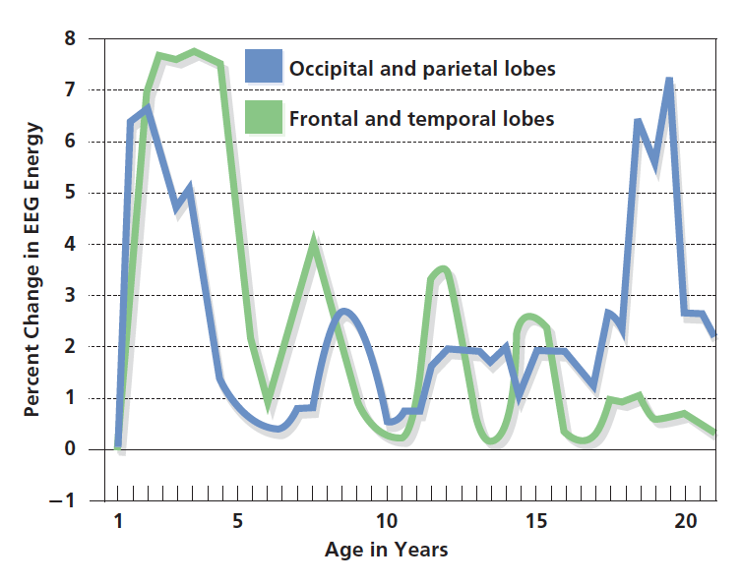
Brain Growth and Cognitive Development
(Fischer & Rose, 1995)

Slide 11
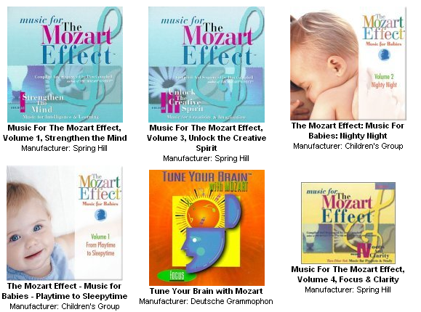
Marketers present misleading scientific evidences
Mozart effects: increase in brain development that occurs in children under age 3 when they listen to the music of W. A. Mozart

Slide 12
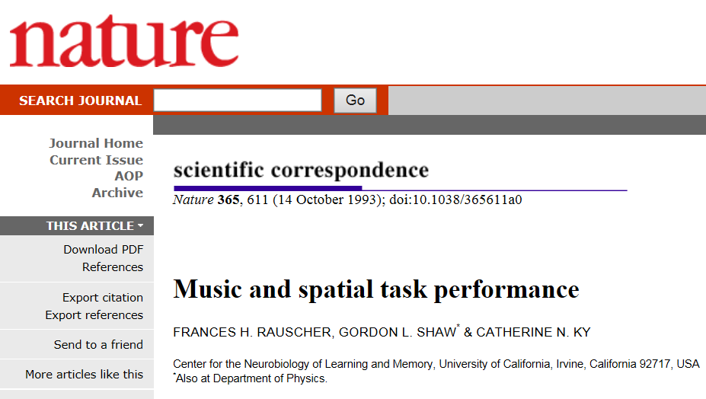

Slide 13
Classical experiment on Mozart effect
(Rauscher, Shaw, & Ky, 1993)
36 college students were recruited
They were randomly assigned to 3 groups
Standard IQ, abstract/ spatial reasoning tasks were administered

Slide 14
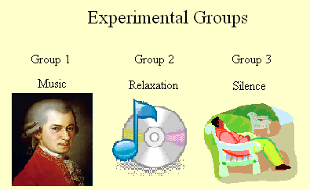
Sonata for Two Pianos in D major, K.488 I. Allegro Con Spirito (8:02)

Slide 15
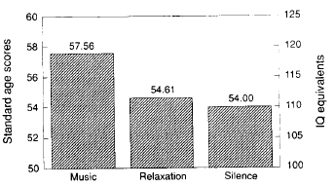
Mozart effect
Participants performed better on the spatial reasoning test only after listening to Mozart

Slide 16
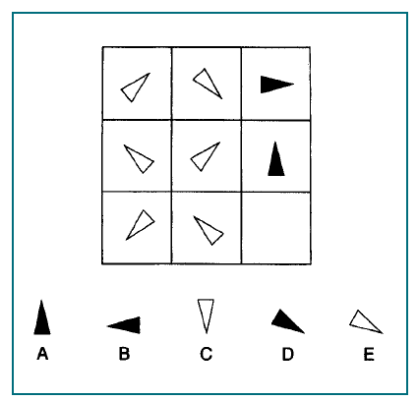
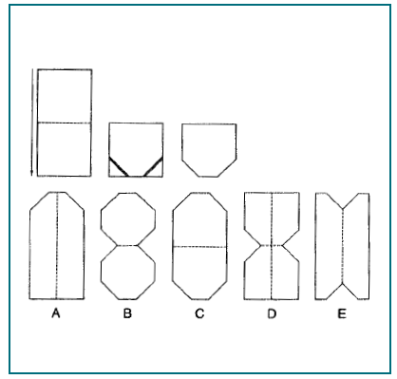

Slide 17
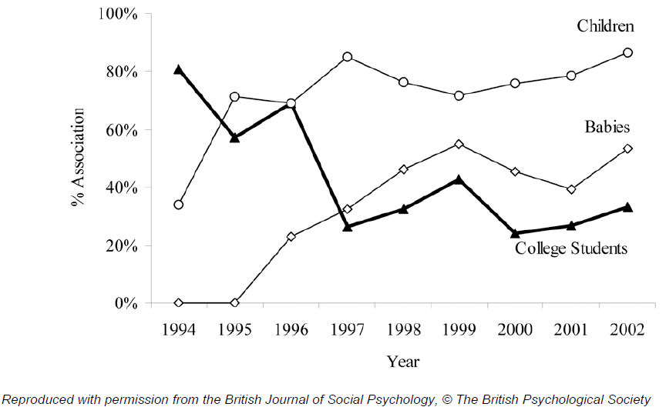
Fig 1 The percentage of popular articles about the Mozart Effect referring to college students, children or babies
Fig 1 The percentage of popular articles about the Mozart Effect referring to college students, children or babies

Slide 18
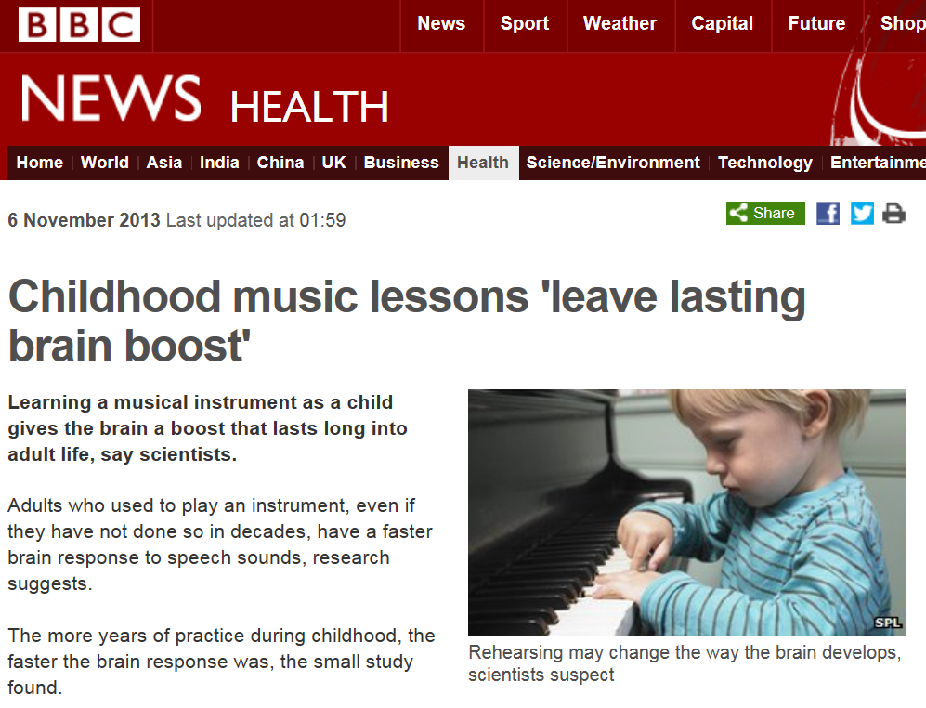

Slide 19
Early diagnosis of disorders
Early identification of developmental disorders prompts more research studies on very young infants
The search of early predictors provides information for early screening and the urge for early learning

