Slide 1
Education in Finland – An introduction
Is there a ”secret”?

Slide 2
How do you do it?
A question that is often asked!
PISA tests
Finnish success has been a surprise for Finns themselves
No secret – just constant reform
Education in Finland is ”apolitical”

Slide 3
This is how we do it
Education system; is it different?
Teachers; the backbone of the system
Special education; is it special or is it mainstream?

Slide 4
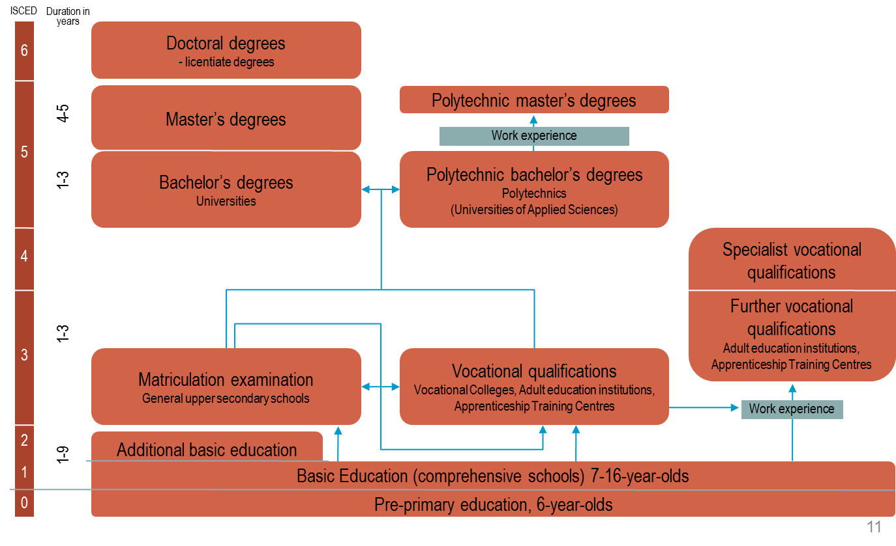
The system

Slide 5
The system and numbers
97% of six-year-olds in voluntary preschool education
99,7% reaches the final certificate in the nine-year compulsory education - drop out rate is only 0,3%
95% continues immediately after compulsory education
51% to general, more academic upper secondary school
42% to vocational upper secondary school
2% to the voluntary tenth year of basic education
5% goes to work and most of them later on to vocational upper secondary education
53,8% of 20 to 24 year-olds studies in universities or in polytechnics

Slide 6
The system and equality
One of the basic principles of Finnish education is that all people must have equal access to high-quality education and training.
In Finland education is free at all levels from pre-primary to higher education.
In pre- primary and basic education the textbooks, daily meal and transportation for students living further away from the school are free for the parents.
The Finnish education system has no dead-ends. Learners can always continue their studies on an upper level of education, whatever choices they make in between.

Slide 7
The system and equality; funding
Most institutions providing basic and upper secondary level education are maintained by local authorities or joint municipal boards.
Responsibility for educational funding is divided between the State and the local authorities.
Pre-primary and basic education is part of the municipal basic services that receive statutory government transfers.
he statutory government transfer is based on the number of 6–15 year olds living in the municipality.
The statutory government transfer for municipal basic services is approximately a third of the calculatory costs.

Slide 8
The system; administration
Education policy is the responsibility of the Ministry of Education and Culture.
The Finnish National Board of Education, is responsible for the implementation of the policy aims.
In cooperation they develop educational objectives, content and methods for early childhood, pre-primary, basic, upper secondary and adult education.
Local administration is the responsibility of local authorities. They make the decisions on allocation of funding, local curricula, recruitment of personnel.
The municipalities have also the autonomy to delegate the decision-making power to the schools.

Slide 9
The system; quality assurance
There are no school inspectors in Finland and the ideology is to steer through information, support and funding. The activities of education providers are guided by objectives laid down in legislation as well as the national core curricula and qualification requirements.
The system relies on the proficiency of teachers and other personnel.
The education system is based on trust and responsibility.

Slide 10
The system; evaluation & assessment
There is strong focus on both self-evaluation of schools and education providers and national evaluations of learning outcomes.
National evaluations of learning outcomes are done regularly, so that there is a test every year either in mother tongue and literature or mathematics.
From the schools’ perspective, the evaluations are not regular as they are sample-based. The education providers receive their own results to be used for development purposes.
The main aim of the national evaluations of learning outcomes is to follow at national level how well the objectives have been reached as, set in the core curricula and qualification requirements.
The results are not used for ranking the schools.

Slide 11
The system; evaluation & assessment
The national core curriculum for basic education is determined by the Finnish National Board of Education.
The education providers draw up their own curricula within the framework of the national core curriculum. Thus there is room for local or regional specificities.
In Finland the main type of pupil assessment is the continuous assessment during the course of studies and final assessment.
One task of basic education is to develop the pupils’ capabilities for self-assessment. The purpose of this is to support the growth of self-knowledge and study skills and to help the pupils to learn to be aware of their progress and learning process.

Slide 12
The system; evaluation & assessment
There are no national tests for pupils in basic education in Finland. Instead, teachers are responsible for the assessment in their respective subjects on the basis of the objectives written into the curriculum.
National assessment of learning outcomes is based on samples of 10 % of the age group; it focuses on grades 3, 5, 7 and 9
Longitudinal assessments are emphasized
The only national examination is at the end of general upper secondary education (at the age of 18 to19)

Slide 13
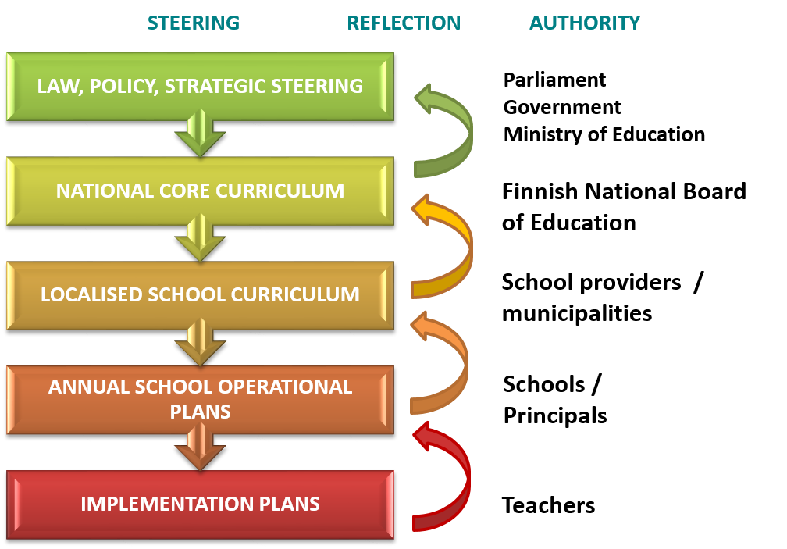
The system; Feedback loop & Continuous reform

Slide 14
The Teacher in Finland
Applicants who took part in first phase entrance test for Finnish-language class teacher education and those selected for class teacher education:
Applicants in participating in national tests
Year 2011 2012 2013
Applicants 8 856 11 976 12 493
Selected 811 879 886

Slide 15
The Teacher; The backbone of Finnish Education
In Finland, teachers are required to have a master’s degree with the exception of kindergarten teachers, whose qualification requirements include a bachelor’s degree.
Teacher education is a popular field of study, and higher education institutions are in a position to select the most well-suited and the most motivated applicants for their programmes.
Higher education institutions decide on student admissions and admission criteria independently.
Entrance tests of universities are used to assess aspects such as academic studying skills and aptitude for the profession.

Slide 16
The Teacher as the Reseacher
The link between teaching and research is emphasised in the teacher education.
The objective is to produce teachers with a research orientation in their work who are capable of independent problem-solving and have the capacity to utilise the most recent research in the fields of education and the subjects taught.
Using these skills, the teacher is able to independently develop both him or herself as a teacher and his or her work community in cooperation with the rest of the staff of the educational institution.

Slide 17
The Teacher; Teacher Education
The objective of professional teacher education is to provide the student with the skills and knowledge to guide the learning of different students and the capabilities to develop his or her field of teaching taking into account developments in the world of work and different professions.
Teacher education also involves pedagogical studies and guided teaching practice, which is implemented in the universities’ own schools for teaching practice or other schools nominated for the purpose.
Guided teaching practice involves the giving of lessons, guidance discussions and familiarisation with tasks and responsibilities related to various issues arising in the everyday life of schools.
The aim is for students in teacher education to become independent and responsible teachers and learn self development, and learn to develop the work community in cooperation with other members of teaching staff.

Slide 18
The Teacher; Autonomy
In Finland, teachers have many professional freedoms and opportunities to impact their work and the development of their work community.
Teachers have the power to decide which teaching methods and learning materials they want to use.
The Finnish system is based on trust in teachers and teacher education. In Finland, no national evaluation or registration of teachers takes place.

Slide 19
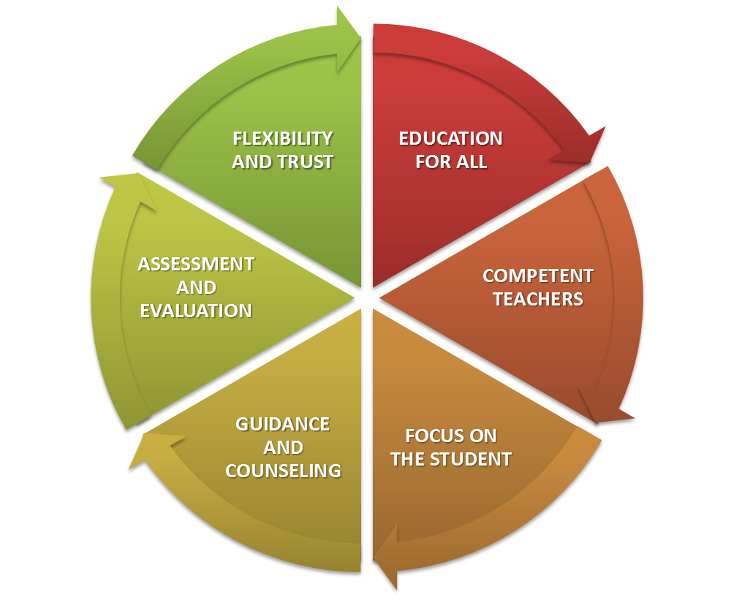
The ”secret” of the Finnish success – is the system

Slide 20
Example Video 1.
”Finland: Maintaining a Strongly Supportive School System” – Pearson Foundation
http://www.youtube.com/watch?v=7Di-59XgNCA

Slide 21
Special Education in Finland
The current thinking in Finland is that the potential of each pupil should be maximised. Therefore educational guidance is seen as essential.
Guidance and counselling aims to support, help and guide pupils and students so that they can all perform as well as possible in their studies.
Guidance and counselling is seen as the work of all education personnel. Thus teachers are required to treat the children and young people as individuals and help them to proceed according to their own capabilities.

Slide 22
Special Education in Finland
In Finland the ideology is to provide special needs education primarily in mainstream education.
If a pupil cannot be taught in a regular teach- ing group, he or she must be admitted to special needs education. This education is provided at regular schools wherever possible.
The aim is to prevent existing problems from becoming more serious or expansive.
The main purpose of special support is to provide pupils with broadly based and systematic help so that they can complete compulsory education and be eligible for upper secondary education.

Slide 23
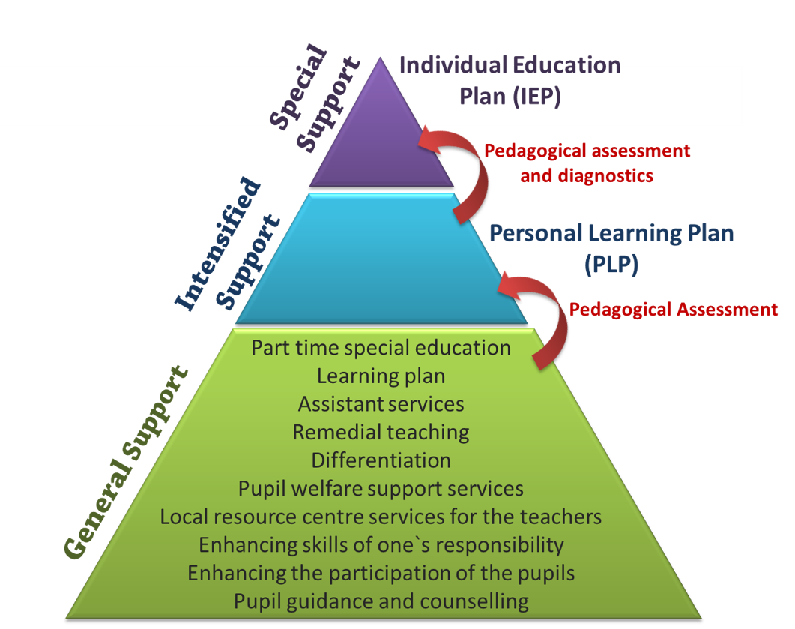
Special Education; Three tiered support system
6,5% (2013)
7,3%
86,2%

Slide 24
Special Education; is really special?
Special education in Finland is not actually special education.
Most students go through ”special education” during their education.
The ones who do not are special!

Slide 25
Example Video 2.
”Finland: Maintaining a Strongly Supportive School System” – Pearson Foundation
http://www.youtube.com/watch?v=7Di-59XgNCA

Slide 26
THANK YOU!
Niko Lindholm
+358 40 778 0919
niko.lindholm@tribalearning.com TribaLearning Oy Ab
www.tribalearning.com

